Slide 1

ASSIGNMENT SUBMISSION
Data Pipeline Designs
SUBMITTED TO :
Sri. Sachin Chaudhary
SUBUMITTED BY :
Shaik Charan

Slide 2
Selected Source: Google Meet
System / Source : Google Meet
Data Produced :
Meeting & Attendance Logs
Meeting ID
Participant ID
Session ID
Join Time
Leave Time
Session Duration
Attendance Status
Main Data Problems
Duplicate Sessions — User disconnects and rejoins
Late Data — Attendance records may arrive later
Overlapping Time — Participant durations can overlap
Goal
Create accurate attendance and meeting analytics from the raw meeting data.

Slide 3
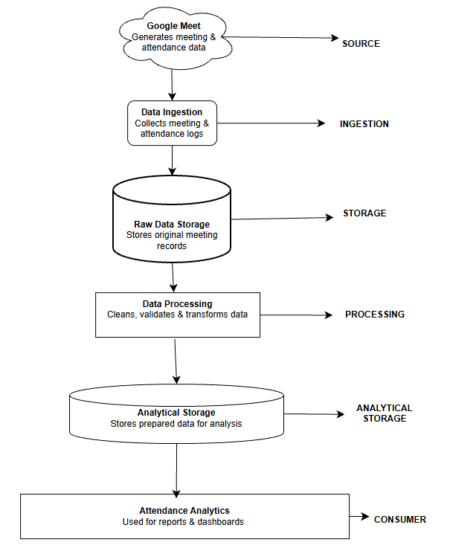
Logical Architecture: Google Meet
Logical Component | Why is this component needed?
Google Meet | Acts as the source where meeting activity is generated.
Data Ingestion | Ensures generated data is collected and brought into the pipeline.
Raw Data Storage | Keeps the original data available for reprocessing and verification.
Data Processing | Handles duplicates, late records and incorrect duration calculations.
Analytical Storage | Provides a reliable dataset for reporting and analysis.
Attendance Analytics | Helps teachers/managers monitor attendance and meeting activity.

Slide 4
Technology Mapping: Google Meet
Logical → Technology Mapping
Google Meet Logs
Logical Component | Actual Technology
Source | Google Meet Logs
Ingestion | Python / API Extraction
Raw Data Storage | Cloud Object Storage
Processing | Python + Pandas
Analytical Storage | PostgreSQL
Consumer | Power BI
Python / API Extraction
Cloud Object Storage
Python + Pandas
Why these technologies?
Google Meet Logs → Provides meeting and attendance data
Python / API Extraction → Collects the meeting data
Cloud Object Storage → Stores the raw data
Python + Pandas → Cleans and transforms the data
PostgreSQL → Stores processed data for analysis
Power BI → Creates attendance and meeting reports
PostgreSQL
Power BI

Slide 5
Each component has a specific job
GOOGLE MEET
Purpose: Generate
Use: Creates meeting & attendance data.
DATA INGESTION
Purpose: Collect
Use: Collects meeting and attendance logs.
RAW DATA STORAGE
Purpose: Preserve
Use: Stores original meeting records.
DATA PROCESSING
Purpose: Refine
Use: Cleans, validates & transforms data.
ANALYTICAL STORAGE
Purpose: Prepare
Use: Stores processed data for analysis
ATTENDANCE ANALYTICS
Purpose: Serve
Use: Provides reports, dashboards & insights.

Slide 6
Architecture / Data Flow Explanation
pipeline 1: Google Meet
Google Meet → Data Ingestion: Meeting activity enters the pipeline.
Data Ingestion → Raw Storage: A copy is kept for safety.
Raw Storage → Processing: Records are checked and prepared.
Processing → Analytical Storage: Corrected results are made ready for use.
Analytical Storage → Analytics: Final data supports attendance reports.
Flow: Generate → Collect → Preserve → Refine → Analyze

Slide 7
Research & Design Decisions: Google Meet
Source | What I found | Design Decision
Google Meet API Documentation | Participant sessions have unique Session IDs and start/end times. | Added Session ID, Join Time and Leave Time to the data model.
Google Meet Participants Guide | A participant can have multiple sessions in the same meeting. | Added duplicate/reconnect session handling.
Google Meet REST API | Conference and participant records can be retrieved through the API. | Selected API-based data ingestion.

Slide 8
Question Log
How do we handle late data?
Process late records correctly.
Why keep raw data?
For reprocessing and verification.
How do we avoid duplicate attendance?
Identify and remove duplicate sessions.
How do we calculate meeting duration?
Handle overlapping sessions correctly.
Why process data before analytics?
To improve data accuracy.

Slide 9

Selected Source: UPI Transaction & Payment Analytics
System / Source: UPI (PhonePe UPI Transaction Data )
Data Produced:
Transaction & Payment Logs
➢ Transaction ID
➢ Sender ID
➢ Beneficiary ID
➢ Amount
➢ Transaction Time
➢ Transaction Status
➢ Debit Status
➢ Credit Status
Main Data Problems :
• Pending Transactions — Debit may happen before credit
• Late Status Updates — Transaction status can change later
• Duplicate Events — Same transaction event may arrive more than once
Failed and reversed payments ----money may be debited and then reversed, so these must not count as completed revenue.
Goal
Create accurate transaction and payment analytics from Phonepe UPI transaction data.

Slide 10
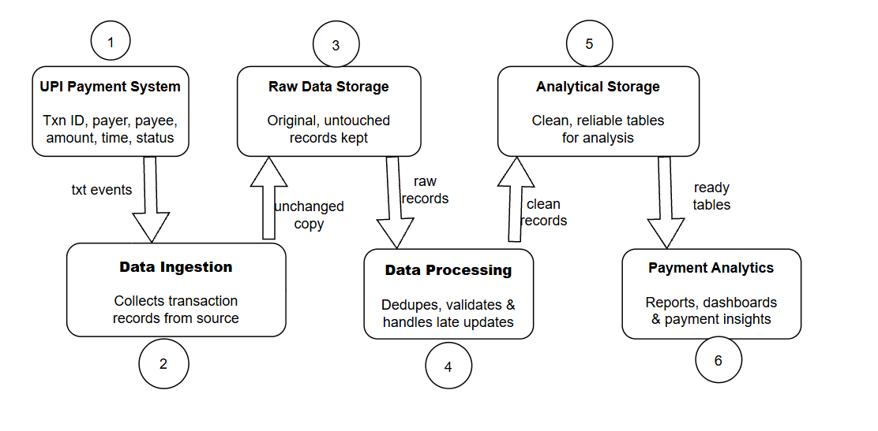
Logical Architecture: UPI & Transaction Analytics
Logical Component | Why is this component needed?
UPI Payment System | Generates payment transactions.
Data Ingestion | Collects transaction data.
Raw Data Storage | Keeps original records.
Data Processing | Handles duplicates and status updates.
Analytical Storage | Stores reliable data for analysis.
Payment Analytics | Provides payment reports and insights.

Slide 11
Technology Mapping: UPI Transaction Analytics
PhonePe UPI Transaction Logs
Logical → Technology Mapping
Logical Component | Actual Technology
Source | PhonePe UPI Transaction Logs
Ingestion | Python / API Extraction
Raw Data Storage | Cloud Object Storage
Processing | Python + Pandas
Analytical Storage | PostgreSQL
Consumer | Power BI
Python / API Extraction
Cloud Object Storage
Python + Pandas
Why these technologies?
PhonePe Logs → Provides transaction data
Python / API → Collects transaction records
Cloud Object Storage → Stores raw data
Python + Pandas → Cleans and processes data
PostgreSQL → Stores processed data
Power BI → Creates transaction reports and dashboards
PostgreSQL
Power BI

Slide 12
Each component has a specific job
RAW DATA STORAGE
Purpose: Preserve
Use: Stores original transaction records.
ANALYTICAL STORAGE
Purpose: Prepare
Use: Stores reliable data for analysis.
UPI PAYMENT SYSTEM
Purpose: Generate
Use: Creates payment transaction data.
DATA INGESTION
Purpose: Collect
Use: Collects transaction records
DATA PROCESSING
Purpose: Refine
Use: Deduplicates and handles status updates.
PAYMENT ANALYTICS
Purpose: Serve
Use: Provides reports, dashboards & insights.

Slide 13
Architecture / Data Flow Explanation
Pipeline 2: UPI / PhonePe
UPI Payment System → Data Ingestion: Payment events enter the pipeline.
Data Ingestion → Raw Storage: Original events are retained.
Raw Storage → Processing: Transactions are checked and reconciled.
Processing → Analytical Storage: Verified results are prepared for analysis.
Analytical Storage → Payment Analytics: Results support payment reports.
Flow: Transact → Collect → Preserve → Reconcile → Analyze

Slide 14
Research & Design Decisions: UPI / PhonePe
Source | What I found | Design Decision
NPCI UPI FAQ | A transaction can remain pending even after the account is debited. | Added Pending/Debit/Credit status tracking.
PhonePe UPI Information | Pending transactions may receive a later final status. | Added late-status update handling.
NPCI Transaction Settlement Lifecycle | UPI transactions follow a transaction and settlement process. | Added reconciliation during data processing.

Slide 15
Question Log
How do we handle pending transactions?
Track status changes until the transaction is resolved.
Why keep raw transaction data?
For reprocessing and verification.
How do we avoid duplicate transactions?
Identify duplicate transaction events.
How do we handle debit-credit mismatch?
Reconcile debit and credit status.
Why process transactions before analytics?
To provide accurate payment insights.

